Slide 1
Recognition and detection of Malicious Facebook Applications using FRAppE
Presented By
SREENIVAS PALEPU(U2013209)

Slide 2
Introduction
Now a days cyber crimes has been threat to the modern world.
There are multiple ways through which hackers can use malicious apps like exploiting privacy or extracting personal information from millions of users connected to Online Social Network.
Infocuses on several harmful third-party apps that are easily accessible through Online Social Network. Even yet, some of them are produced by spammers and hackers to acquire sensitive personal data from consumers.
This paper discusses about the machine learning approach using different algorithms to detect malicious urls and apps.

Slide 3
Aim and Objectives
Aim
To develop an AI based system to detect the malicious applications and urls on social media platform.
Objectives
To research in-depth about the Online social Network applications.
To conduct in-depth research about malicious facebook applications and processes to track them down.
To develop an efficient Python code to determine the required output in terms of determining malicious apps.
Implementing an appropriate machine learning algorithm to attain desired output.

Slide 4
Summary of Literature Review and Findings
Technology has only made this easier as one can understand a lot through the choices people
make visible in the digital world. This is why one can feel ML can play a huge role.
The existing approach merely provides a high-level overview of risks to the Facebook graph and does not perform the system analysis.
Instead of malicious applications, the existing system focuses on accounts generated by spammers.

Slide 5
Proposed Solutions to Identified problems
To Develop a model using machine Learning which is prevents the online Social Network users who are spammed by hackers.
This Model which is most of the cyber crime like fraud transactions ,blackmails and sharing of important documents.

Slide 6
Methodology (Research methods used qualitative, quantitative or simulation)
Primary research is the type of research method in which the researcher owns the data by directly collecting the data from the surveys or interviews conducted to find a solution for the research question.
In this research, the research approach has been implied in which the datasets are collected from multiple journals and articles containing information about the third-party So, the qualitative data has been chosen in that secondary data.
For background and introductory information – research articles are being used.
For general information like history – texts from social media is being preferred.
We collected datasets from cradle.com where you can find various

Slide 7
Practical Implementation and Output from practical work
In this Artificial Intelligence based research python is a multi-level programming language used as a interface for various stages of implementation.
In this research used Anaconda and Google colabs as Integrated Development Environment(IDE).
Different alogorithms has been used to achieve maximum amount of efficiency of the model.
The alogorithms mentioned above are
Random Forest algorithm.
Decision tree algorithm.
Convolutional Neural Networks.

Slide 8
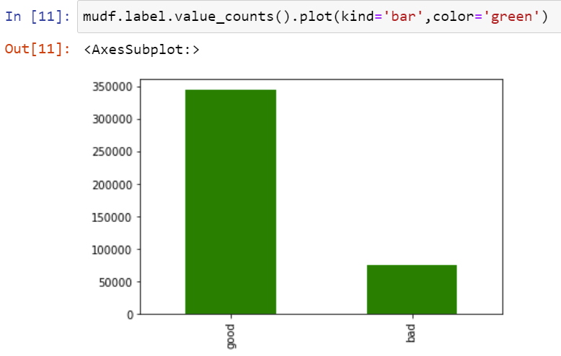
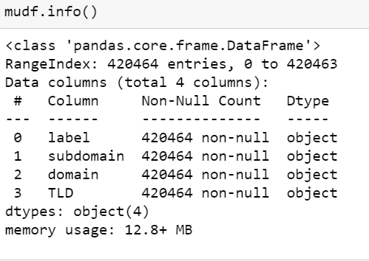
Output
The below plot is a visualization of all the 16 personality traits concerning the number of occurrences.

Slide 9
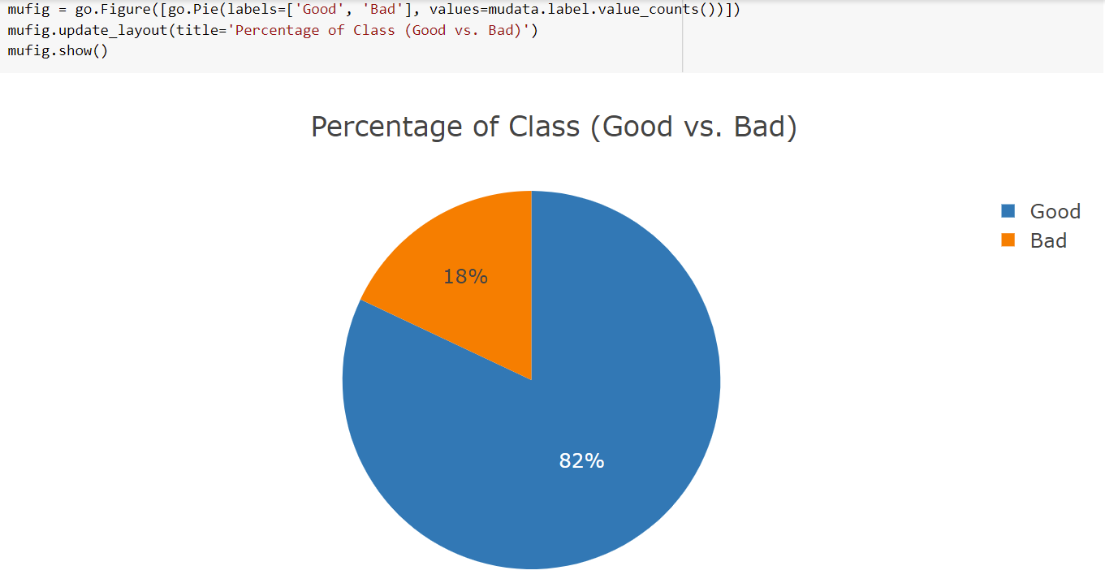
output
Percentage of labeled data

Slide 10
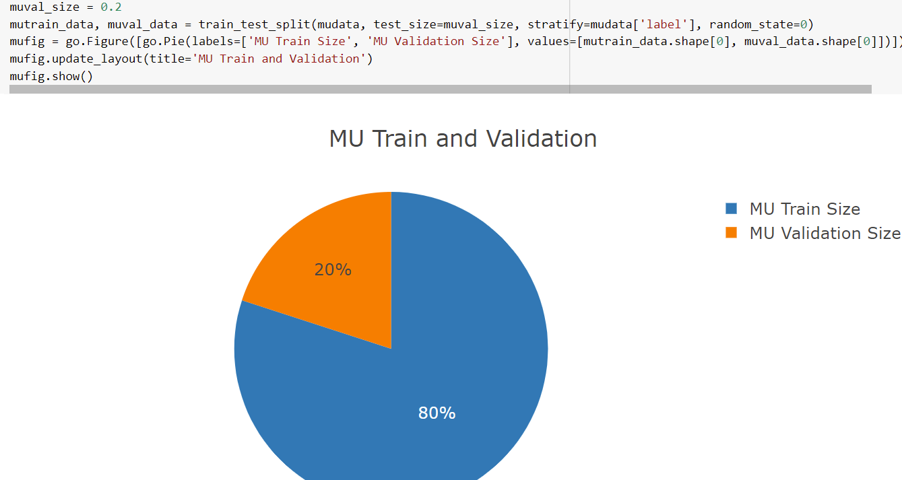
output
Training data vs Testing data

Slide 11
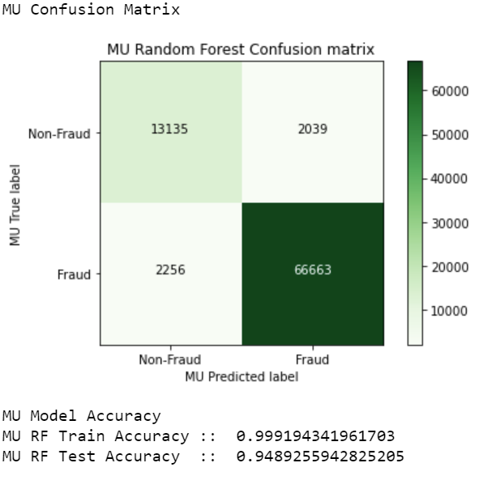
output
Confusion Matrix of Random Forest

Slide 12
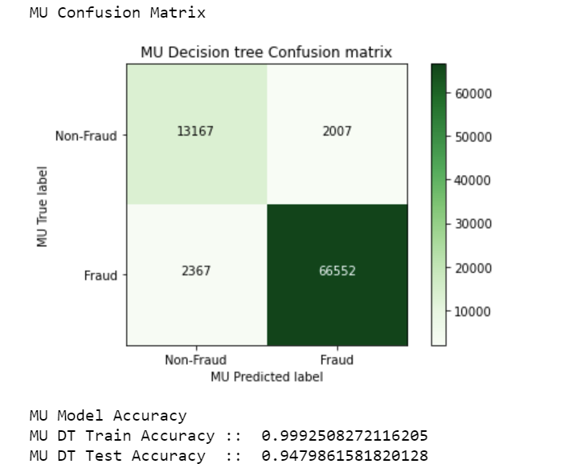
output
Confusion matrix for Decision Tree
From the matrix we can see fraud to non –fraud mapping
In this is model 95% of accuracy.has been achieved

Slide 13
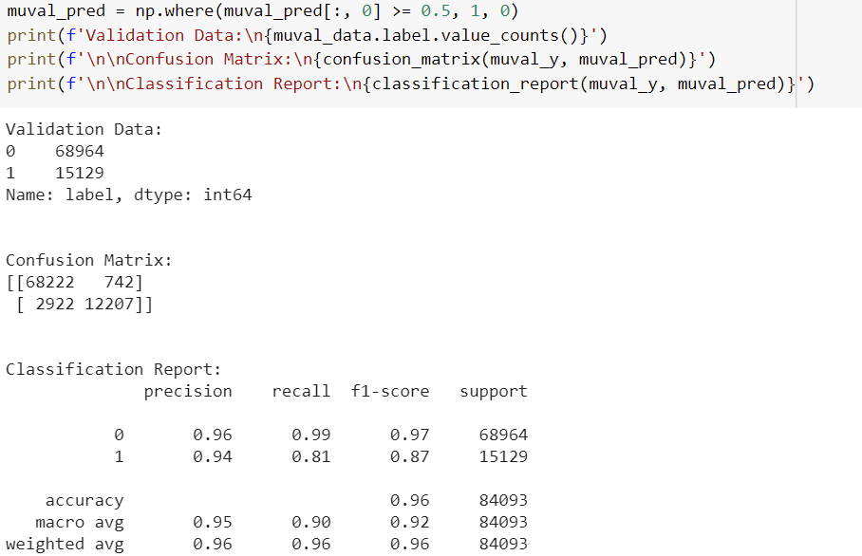
output
Confusion Matrix for Convolutional Neural Networks(CNN)

Slide 14
Evaluation – discuss the results from the practical work
The datasets are inputed into each algorithm and each algorithm has its own accuracy rate and Confusion matrix.
Confusion matrix is metric that is used to evaluate each algorithm.
From Confusion matrix we can derive the misclassification of urls .

Slide 15
Conclusion
This research took the input as some of the statements of few people and accurately predicted their personality with machine learning.
In this way with of this research one easily recognize the personality of any person only through their text messages.
Shallower and Deeper CNN must be more efficient when compared to standard machine learning algorithms.so that better results can be retrieved.
Various datasets can be used to check the predictability of the model.

Slide 16
Recommendation
This model can be applicable various online social network ,webapplication and mobile applications.

Slide 17
THANK YOU!

